Slide 1
Assignment 2 and 3
Virtualization
Virtualbox
Vagrant
CS319

Slide 2
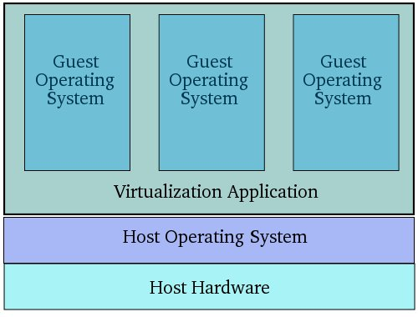
Virtualization
CS319

Slide 3

Virtualbox
Virtualbox is a powerful virtualization product for enterprise as well as home use.
Other products:
  VMWare ESXi (Enterprise)
  VMWare Desktop (home use)
  Microsoft Hyper-V (Enterprise)
  Parallels Desktop for Mac
  https://en.wikipedia.org/wiki/Comparison_of_platform_virtualization_software
CS319

Slide 4

Vagrant
Ordinarily, the task of setting up your virtual machine and downloading and installing your guest operating system is a manual tedious process
Vagrant automates these tasks with simple, easy to use commands.
CS319

Slide 5
Demo
CS319

